Slide 1

Department of Artificial Intelligence and Data Science
Real-Time Ingredient Recognition and Recipe Generator
Mrs.Y.Nirmala Anandhi
Sanjay B (221801045)
Soorya B (221801051)
Thofiq Gani M (221801057)

Slide 2
Problem Statement and Motivation
Manual recipe planning is time-consuming, often leading to food waste due to unused ingredients. Existing apps lack real-time ingredient recognition and dynamic recipe generation, limiting user convenience and efficiency in meal preparation.The Motivation growing need for smart kitchen solutions to minimize food waste, simplify cooking, and assist users in creating meals from available ingredients motivates this project. AI-driven automation can enhance culinary experiences while promoting sustainability.

Slide 3
Methodology
The proposed system works in four main stages. First, the User Interface and Input Module allowsusers to upload or capture an image of ingredients in real time. The image is preprocessed by resizing and enhancing it to make it suitable for detection. Next, the Ingredient Detection Module uses a YOLO model to detect and identify multiple ingredients present in the image. It outputs a list of ingredients with labels such as “tomato,” “onion,” or “potato.” Then, the Recipe Retrieval and Generation Module takes these detected ingredients and searches a recipe dataset (CSV file) to find matching recipes. A BERT-based model refines and generates clear, step-by-step recipe instructions with proper measurements. Finally,the Output and Display Module presents the complete recipe in a user-friendly format, including the ingredient list, cooking steps, and optionally images or videos. This step ensures the user receives a well-structured and visually appealing recipe based on the ingredients they have.

Slide 4
List of Modules
User Interface & Input Module
Provides an interactive interface for the user.
Allows users to upload images or capture images via camera.
Performs initial preprocessing of images:
  Resizing to standard dimensions.
  Color normalization or enhancement.
  Optional noise reduction.
Ensures the image is ready for the detection module.
Input: User image (camera capture or upload).
Output: Preprocessed image ready for ingredient detection.

Slide 5
List of Modules
Ingredient Detection Module (YOLOv12)
Detects and identifies multiple ingredients in real time.
Uses a YOLOv12 object detection model for fast and accurate recognition.
Processes the preprocessed image from the UI module.
Generates a list of detected ingredients with:
  Labels (e.g., tomato, onion, potato).
  Confidence scores.
  Optional bounding box coordinates.
Input: Preprocessed image from UI/Input module.
Output: List of detected ingredients with labels.

Slide 6
List of Modules
Recipe Retrieval & Generation Module (CSV + BERT)
Retrieves recipes from a CSV dataset based on the detected ingredients.
Filters and ranks recipes for the best matches.
Uses BERT to refine recipe instructions:
  Makes the instructions coherent and easy to read.
  Ensures proper sequencing of steps.
  Adjusts ingredient quantities or measurements if necessary.
Input: Detected ingredient list from YOLO; CSV dataset.
Output: Refined, human-readable recipe instructions.

Slide 7
List of Modules
Final Output & Display Module
Presents the complete recipe to the user in an organized format.
Includes:
  Ingredient list.
  Step-by-step cooking instructions.
  Optional images or videos for better guidance.
Ensures the recipe is display-ready and user-friendly.
Input: Refined recipe instructions from the Recipe Generation module.
Output: Display-ready recipe with all details and multimedia elements.

Slide 8
Workflow Summary
User uploads or captures an image of ingredients.
Image is preprocessed for detection.
YOLOv12 detects ingredients and gives a list of labels.
Detected ingredients are used to search recipes in the CSV dataset.
BERT refines the recipe into clear, step-by-step instructions.
Final recipe is displayed with ingredients, steps, and optional images or videos.

Slide 9
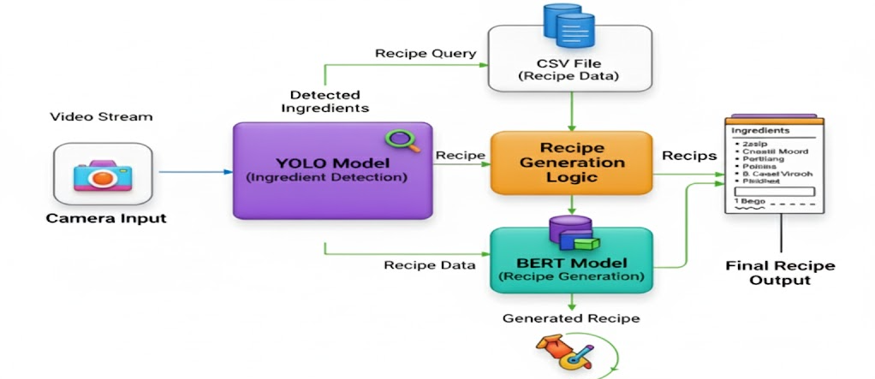
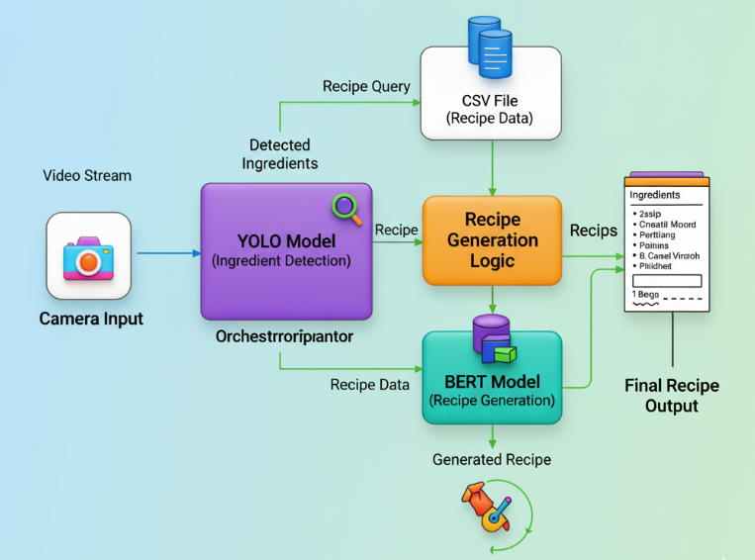
Architecture Diagram

Slide 10
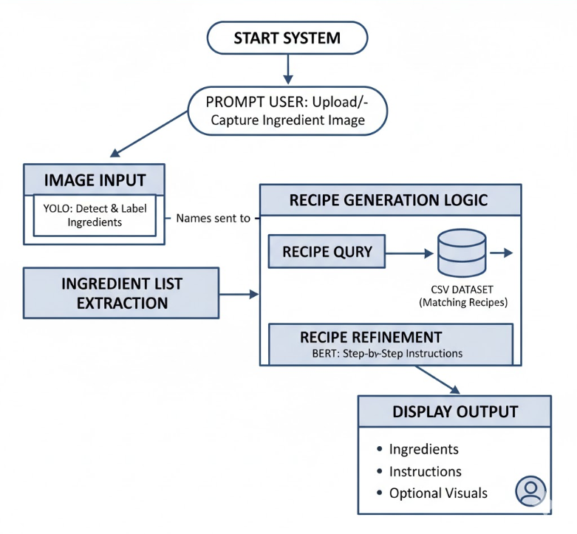
System Flow Diagram

Slide 11
Thank You

